Slide 1
Eyeborg system.

Slide 2
3
Brain-Computer interface (BCI)

Slide 3
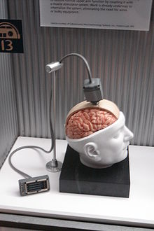
Also called direct neural interface
The concept is linking between BRAIN and computerized system
Done by implanting electrodes into grey matter of brain
aim at restoring damaged hearing, sight and movement

Slide 4
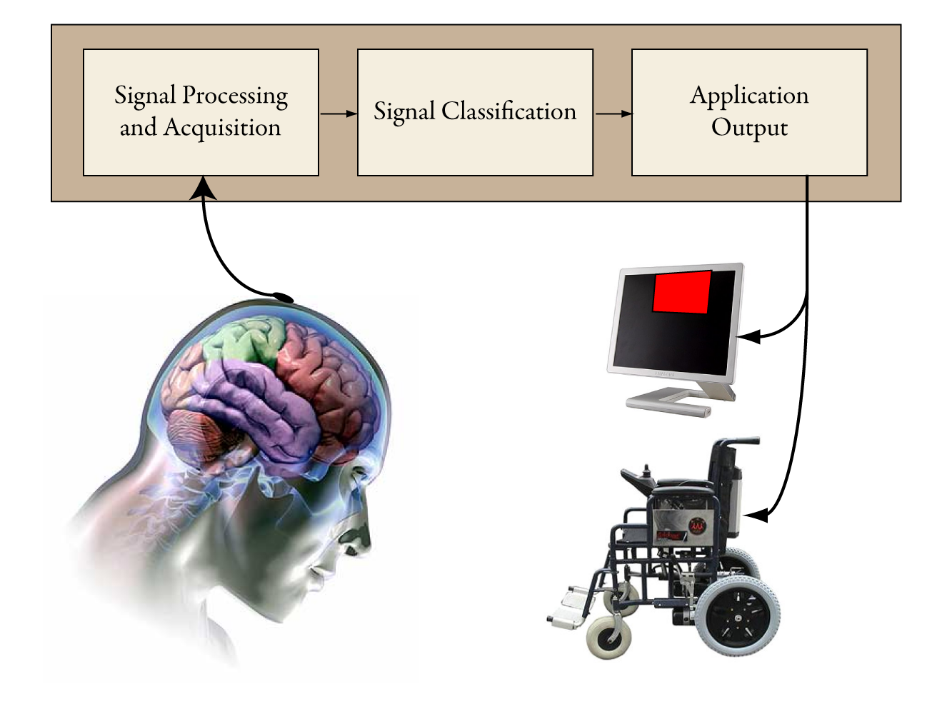

Slide 5
Brain-Computer Interface.

Slide 6
4
Mechanical Heart Implantation (Artificial Heart).

Slide 7
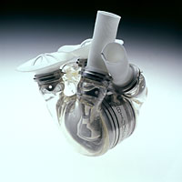
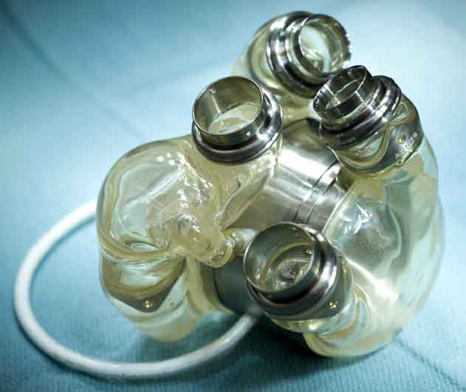
On morning of April,1969
Dr.Domingo Liotta and Dr.Denton Cooly replaced patient’s heart with mechanical artificial one .
After 64hr, the pneumatic powered artificial heart removed and replaced by donor’s one.
The replacement was Bad Decision.
The patient died after 36 hrs.,
Acute pulmonary infection in both lungs caused by fungi owing to IMMUNOSUPPRESSIVE-drugs complication
By 2004, a fully functionally artificial heart was developed.

Slide 8
5
Cochlear Implantation.

Slide 9
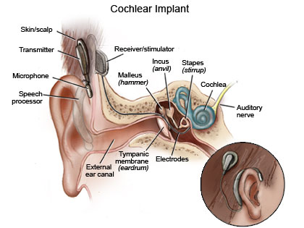
Restore here loss to normal or improved state.
Building components:
1-microphone.
Collects sounds to speech processor.
2-speech processor
Sort the collected sound
2-transmitter / receiver.
Convert signals from processor into electric pulses
3-electrode array.
Send signals to auditory nerve.

Slide 10
Michael Chorost
HOW BECOMING PART COMPUTER MADE ME MORE HUMAN
“IF DEAFNESS IS KIND OF DEATH, HEARIN AGAIN IS A KIND OF REBIRTH.BUT INTO A DIFFERENT BODY”

Slide 11
Cyborg in Military.
1
Cyborg Sharks

Slide 12
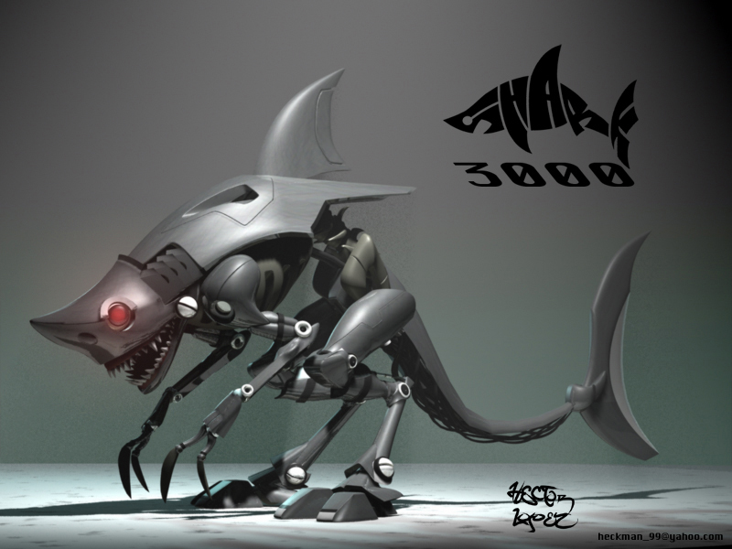
Defense Advanced Research Projects Agency
Neural implant remotely controlled sharks
Provide Feedback data about enemies’ ship movement and underwater explosives

Slide 13
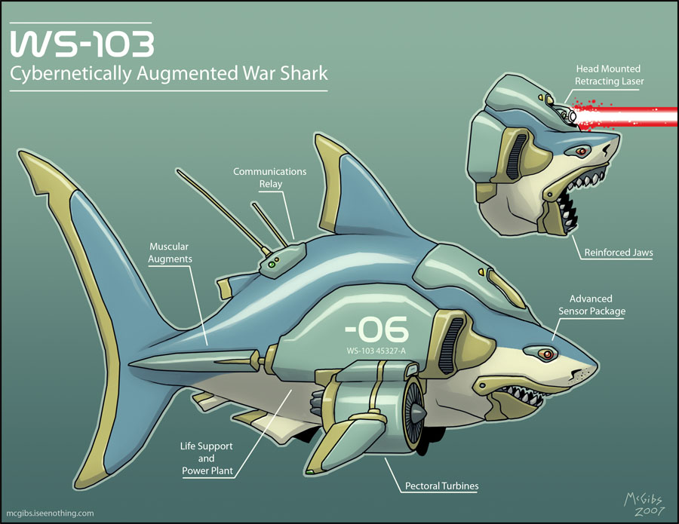

Slide 14
2
Cyborg Bugs and Beetles.

Slide 15
Cyborg insects transmit data
Sensors implanted into insect at the pupal stage.
The insect motion would be controlled from MEMS (Micro-Electro-Mechanical Systems)
Equipped with embedded microphones, gas sensors and radars
Detect gases or explosives.
May used in spying and transmitting secrets of countries or VIPs
In 2009, the IEEE(institute of Electrical and Electronic Engineers the MEMS conference held in Italy demonstrated the first wireless beetle or remote controlled beetle developed by co-operation between CALTECH and DARPA.

Slide 16
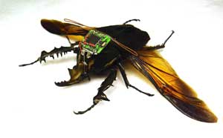
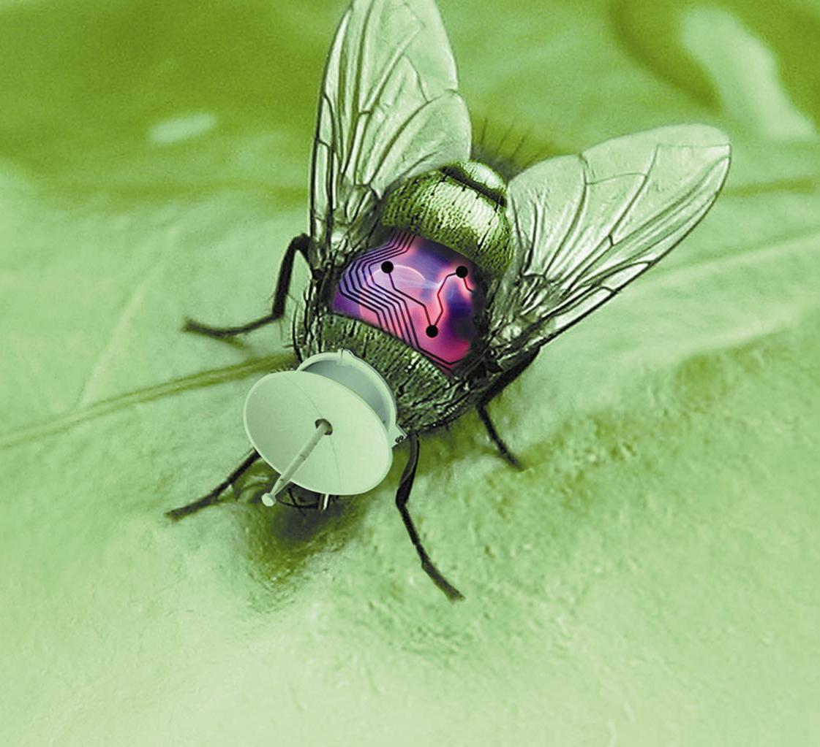
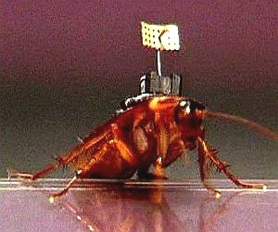

Slide 17
Cyborg Insect.(CALTECH&DARPA)

Slide 18
Cyborg in art and popular culture.

Slide 19
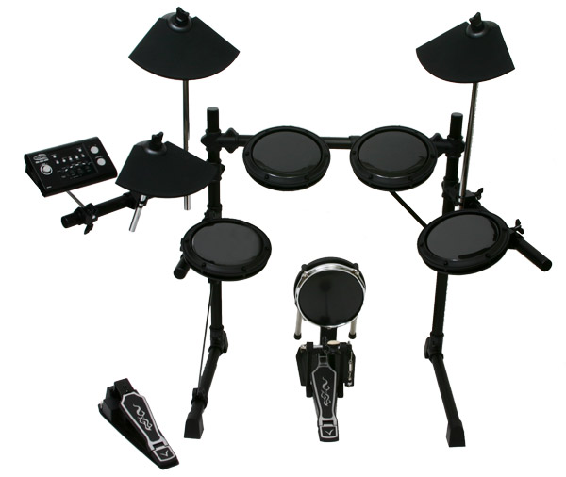
The concept the cyborg was often related to science fiction.
Computerized drawing pads replaced pen and papers
Drum machines became fully computerized
Softwares on pcs replaced whole studios.

Slide 20
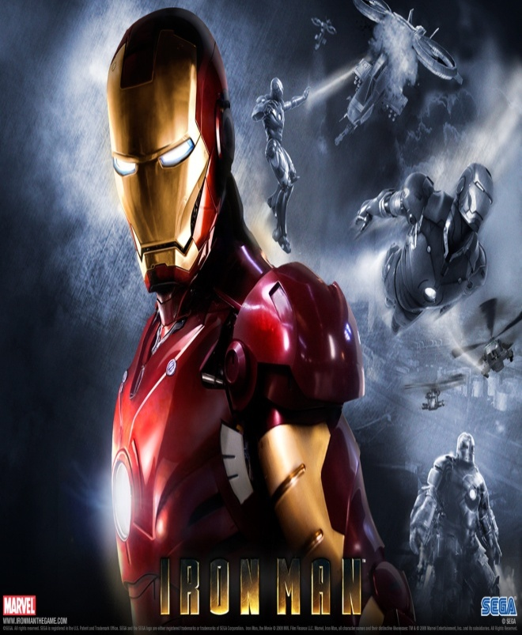
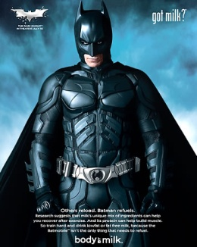
Cinema:-
Cyborg concept was present but without mentioning (indirectly)

Slide 21
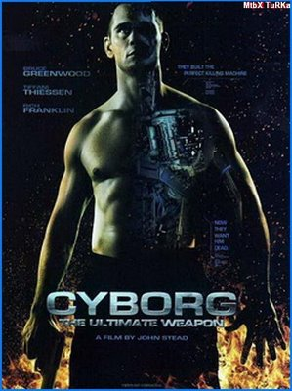
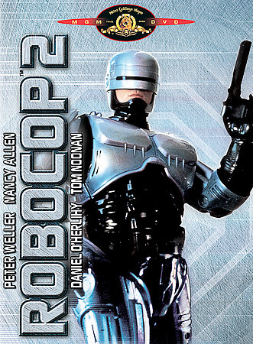
Nowadays mentioned intentionally or its concept

Slide 22
Most actor pay his most attention to cyborg and man-machine mix is Arnold Schwarzenegger specially in

Slide 23
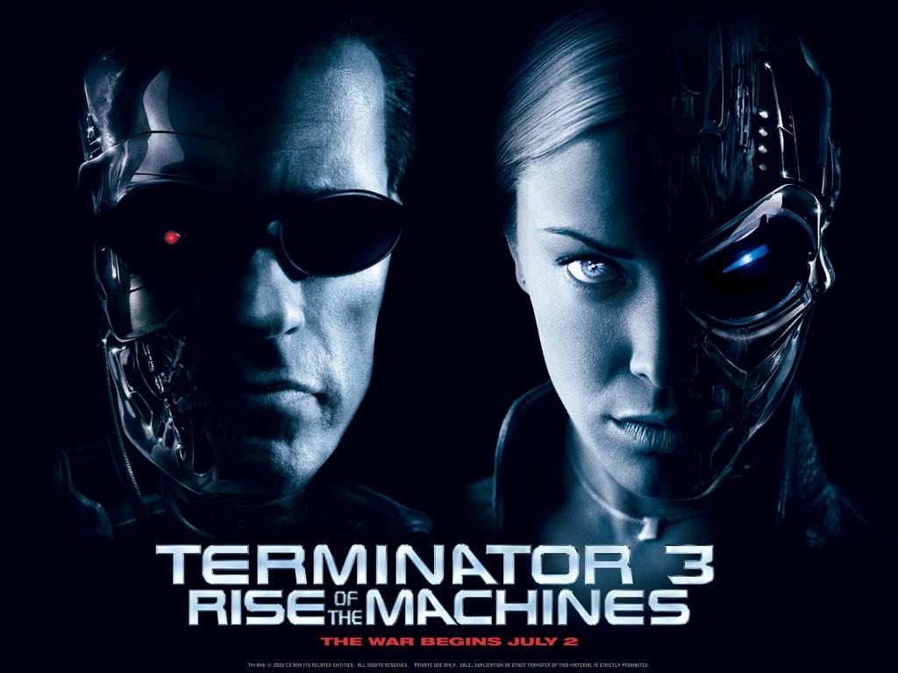

Slide 24
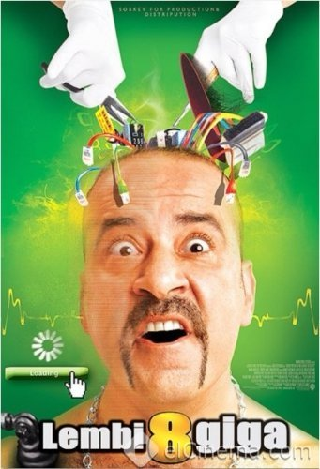
Egyptian Cyborg Model

Slide 26
Conclusion and Outcomes

Slide 27
Advantages of being a cyborg:-
There will not be handicaps anymore.
Enhancing abilities of human beings.
Save life of people with critical diseases.
Ease of getting access to information
Make human better soldier, superhero and may also a better lover.

Slide 28
Disadvantages:-
Ethical consideration should be kept in mind.
Developing harmful destructive abilities and weapons.
Political and religious affaires will interfere with this technology.
Pollution to the environment.

Slide 29
بسم الله الرحمن الرحيم
لقد خلقنا الإنسان في أحسن تقويم
بسم الله الرحمن الرحيم
إنا كـــل شــيء خلقناه بقدر

